Slide 1
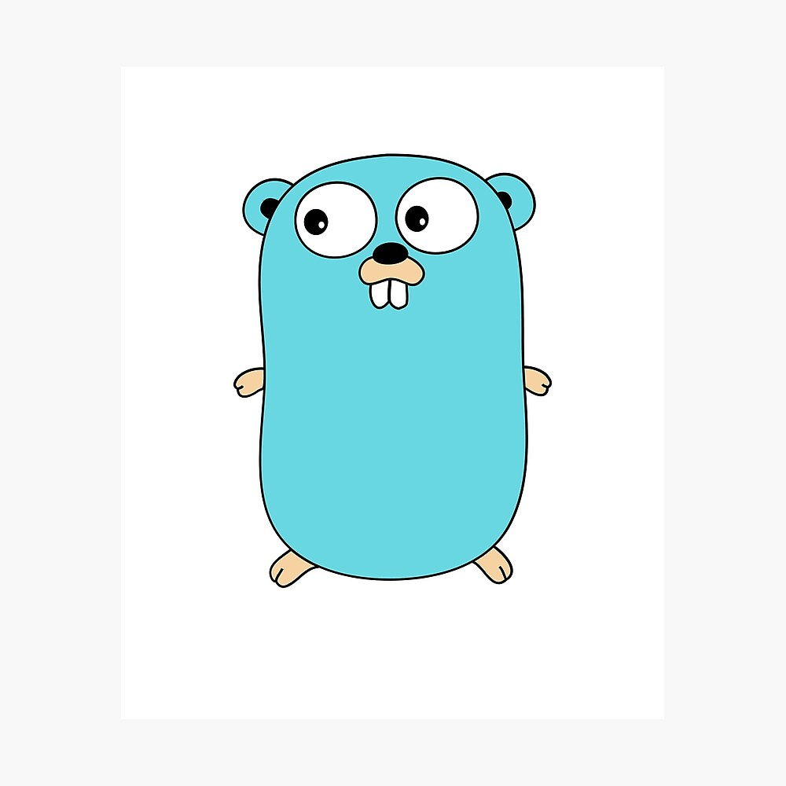
Array, slice, map

Slide 2
Single array tanpa deklarasi langsung
var animals [3]string
animals[0] = "giraffe"
animals[1] = "lion"
animals[2] = "ostritch"
fmt.Println(animals)
fmt.Println()

Slide 3
Single array dengan deklarasi langsung
var flowers = [3]string{"Lily", "Rose","Jasmine"}
fmt.Println(flowers)
fmt.Println()

Slide 4
Multi array
var numbers [3][3]int
numbers[0][0] = 1
numbers[0][1] = 3
numbers[0][2] = 5
numbers[1][0] = 2
numbers[1][1] = 4
numbers[1][2] = 6
numbers[2][0] = 16
numbers[2][1] = 32
numbers[2][2] = 64
fmt.Println(numbers)
fmt.Println()

Slide 5
Slice
newAnimals := animals[0:2]
for _, animal := range newAnimals {
fmt.Println(animal)
}
fmt.Println()
newNumber := numbers[0:1][0:2]
for _, number := range newNumber {
fmt.Println(number)
}
fmt.Println()

Slide 6
Slice
subject := map[string]string{}
subject["monday"] = "math"
subject["tuesday"] = "history"
subject["wednesday"] = "biology"
subject["thursday"] = "physics"
subject["friday"] = "chemical"
fmt.Println(subject)
fmt.Println(subject["thursday"])
fmt.Println()

Slide 7
Slice
prime := map[int]int{}
prime[0] = 2
prime[1] = 3
prime[2] = 5
prime[3] = 7
fmt.Println(prime)
fmt.Println(prime[0])

Slide 8
Thank you
andrewmanuelt@gmail.com

